Slide 1


ADMIS Lab
先进数据与机器智能系统实验室
Intermediate SQL
Chapter 4
Yichao Zhang
Email: yichaozhang@tongji.edu.cn
Department of Computer Science and Technology
Tongji University

Slide 2
Outline
Join Expressions
Views
Transactions
Integrity Constraints
Data Types in SQL
Index Definition in SQL
Authorization

Slide 3
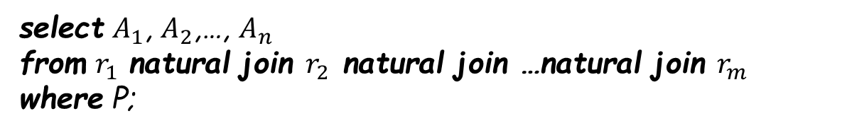
The Natural Join
select $A_{1}$, $A_{2}$,…, $A_{n}$
from $r_{1}$ natural join $r_{2}$ natural join …natural join $r_{m}$
where P;
select name, course_id
from instructor natural join teaches;
select name, title
from instructor natural join teaches, course
where teaches.course_id=course.course_id;
Notes:
Notice that we do not repeat those attributes that appear in the schemas of both relations; rather they appear only once. Notice also the order in which the attributes are listed: first the attributes common to the schemas of both relations, second those attributes unique to the schema of the first relation, and finally, those attributes unique to the schema of the second relation.

Slide 4
Join Expressions
Join operation
  Take two relations and return another relation as the results
Join type
  Define how tuples in each relation that do not match any tuple in the other relation (based on the join condition) are treated
Join condition
  Define which tuples in the two relations match, and what attributes are present in the result of the join
Join Types
Join Conditions
inner join
left outer join
right outer join
full outer join
natural
on <predicate>
using (A₁, A₂, ..., A_{n})
Notes:
In contrast, the join operations we studied earlier that don’t preserve nonmatched tuples are called inner join operations, to distinguish them from the outer-join operations.

Slide 5
Relations for Examples
loan_number
branch_name
amount
customer_name
loan_number
L-170
L-230
L-260
Downtown
Redwood
Perryridge
3000
4000
1700
Jones
Smith
Hayes
L-170
L-230
L-155
Relation loan
Relation borrower
Note: borrower information is missing for L-260 and loan information is missing for L-155
Notes:
outer join的用处就是显示那些暂时还没有值的记录。

Slide 6
Joined Relations – Examples
loan inner join borrower on
loan.loan_number = borrower.loan_number
Loan_number
Branch_name
amount
Customer_name
Loan_number
L-170
L-230
Downtown
Redwood
3000
4000
Jones
Smith
L-170
L-230
loan left outer join borrower on
loan.loan_number = borrower.loan_number
Loan_number
Branch_name
amount
Customer_name
Loan_number
L-170
L-230
L-260
Downtown
Redwood
Perryridge
3000
4000
1700
Jones
Smith
null
L-170
L-230
null

Slide 7
Joined Relations – Examples
loan natural inner join borrower
Loan_number
Branch_name
amount
Customer_name
L-170
L-230
Downtown
Redwood
3000
4000
Jones
Smith
loan natural right outer join borrower
Loan_number
Branch_name
amount
Customer_name
L-170
L-230
L-155
Downtown
Redwood
null
3000
4000
null
Jones
Smith
Hayes

Slide 8
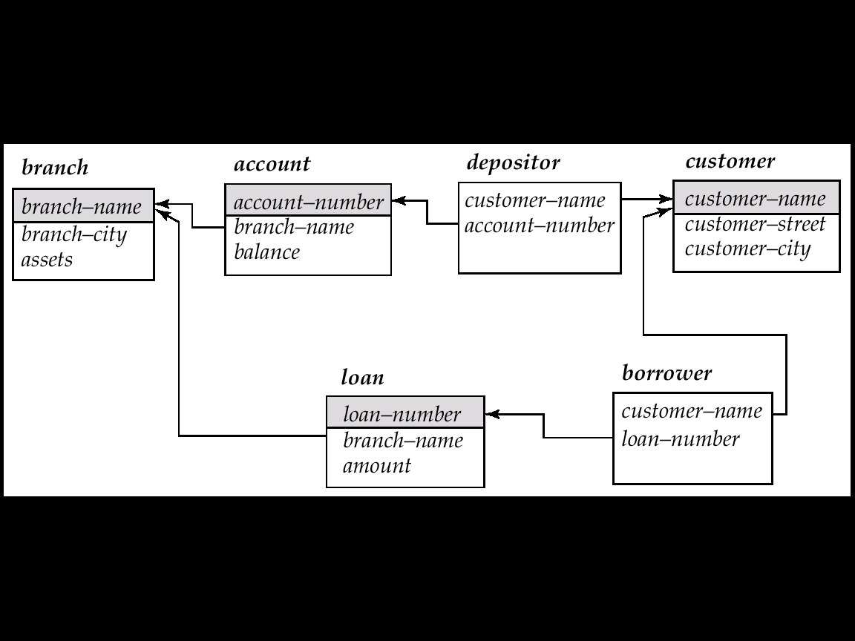
Joined Relations – Examples
loan full outer join borrower using (loan_number)
Loan_number
Branch_name
amount
Customer_name
L-170
L-230
L-260
L-155
Downtown
Redwood
Perryridge
null
3000
4000
1700
null
Jones
Smith
null
Hayes
Find all customers who have either an account or a loan (but not both) at the bank:
select customer_name
from (depositor natural full outer join borrower)
where account_number is null or loan_number is null
Notes:
这里删除了重复属性是因为join-using就是自然连接。

Slide 9
Differences
join on/join using
  on is a predicate
  using specifies the attributes for natural join
join on/where
select name, title
from (instructor natural join teaches) join course using (course_id);
select *
from student left outer join takes on student.ID=takes.ID
select *
from student left outer join takes on true
where student.ID=takes.ID
Notes:
join 也是自然连接，using用来指代其需要连接的属性，即使相同但不在里面的属性不用来连接。
Join on：结果中会出现ID也为NULL的情况，比如学生没有选课，就没有课的ID。on为join的一部分，一旦连接不成自动生成NULL。
Where：因为上面join on true，因为断言的结论一直为真（就是没有空集），实际上产生的是笛卡尔集合，因此不会出现NULL连接的情况，无法产生outer join的效果。

Slide 10
Outline
Join Expressions
Views
Transactions
Integrity Constraints
Data Types in SQL
Index Definition in SQL
Authorization

Slide 11
View and View Updates
Create a view of all loan data in relation loan, hiding the attribute amount
create view branch_loan as
select branch_name, loan_number
from loan
Add a new tuple to relation branch_loan
insert into branch_loan
values (‘Perryridge’, ‘L-307’)
This insertion should be represented by the insertion of the tuple
(‘Perryridge’, ‘L-307’, null)
into the relation loan

Slide 12
Update of a View (Cont.)
Updates on complex views are difficult or impossible to translate, and hence are disallowed
In general, an SQL view is updatable if:
  The select clause contains only attribute names of the relation, and does not have any expressions, aggregates, or distinct specification
  Any attributes not listed in the select clause can be set to null
  The from clause has only one relation
  The query does not have a group by or having clause

Slide 13
Materialized View (物化视图)
The relation of a view is stored
Will change if the actual relations used in the view definition change. The view is kept up-to-date
Materialized view maintenance
  Real-time updates vs. periodic updates
Notes:
the aggregated result is likely to be much smaller than the large relations on which the view is defined; as a result
the materialized view can be used to answer the query very quickly, avoiding
reading the large underlying relations. Of course, the benefits to queries from
the materialization of a view must be weighed against the storage costs and the
added overhead for updates.

Slide 14
Outline
Join Expressions
Views
Transactions
Integrity Constraints
Data Types in SQL
Index Definition in SQL
Authorization

Slide 15
Transactions
A transaction is a sequence of queries and update statements executed as a single unit
Transactions are started implicitly and terminated by one of
  commit [work]: make all updates of the transaction permanent in the database
  rollback [work]: undo all updates performed by the transaction

Slide 16
Transactions (Cont.)
E.g., transfering money from one account to another involves two steps: deduct from one account and credit to another
  If one step succeeds and the other fails, database is in an inconsistent state
  Either both steps should succeed or neither should
If any step of a transaction fails, all work done by the transaction should be undone by rollback work
Rollback of incomplete transactions is done automatically, in case of system failures

Slide 17
Transactions (Cont.)
In most database systems, each SQL statement that executes successfully is automatically committed
  Each transaction consists of only a single statement
  Automatic commit can be turned off, allowing multi-statement transactions, but depends on the database system
  Another option in SQL1999: enclose statements within
    begin atomic
    …
    end

Slide 18
Outline
Join Expressions
Views
Transactions
Integrity Constraints
Data Types in SQL
Index Definition in SQL
Authorization

Slide 19
Integrity Constraints
Integrity constraints guard against accidental damage to the database
  by ensuring that authorized changes to the database do not result in a loss of data consistency
Types
  Domain constraints
  Not null constraint
  Unique constraint
  Referential integrity
  …

Slide 20
Domain Constraints (域约束)
Domain constraints are the most elementary form of integrity constraint
New domains can be created from existing data types, e.g.,
create domain Dollars numeric(12, 2)
create domain Pounds numeric(12, 2)
  cannot assign or compare a value of type Dollars with a value of type Pounds
The check clause permits domains to be restricted
create domain hourly_wage numeric(5, 2)
constraint value_test check(value >= 6.00)
  The domain has a constraint to ensure that the hourly_wage is greater than 6.00
  The clause constraint value_test is optional but useful to indicate which constraint an update violates

Slide 21
Not Null Constraint
Declare branch_name for relation branch to be not null
branch_name varchar(15) not null
Declare the domain Dollars to be not null
create domain Dollars numeric(12,2) not null

Slide 22

Unique Constraint
unique ($A_{1},A_{2},…,A_{m}$)
  The unique specification states that the attributes $A_{1},A_{2},…,A_{m}$ form a candidate key
  Candidate keys are permitted to be null (in contrast to primary keys)
Notes:
However, candidate key attributes are permitted to be null unless they have explicitly been declared to be not null. Recall that a null value does not equal any other value

Slide 23
The check Clause
check (P), where P is a predicate
  E.g., declare branch_name as the primary key for relation branch and ensure that the values of assets are non-negative
create table branch
(branch_name char(15),
branch_city char(30),
assets integer,
primary key (branch_name),
check (assets >= 0))

Slide 24
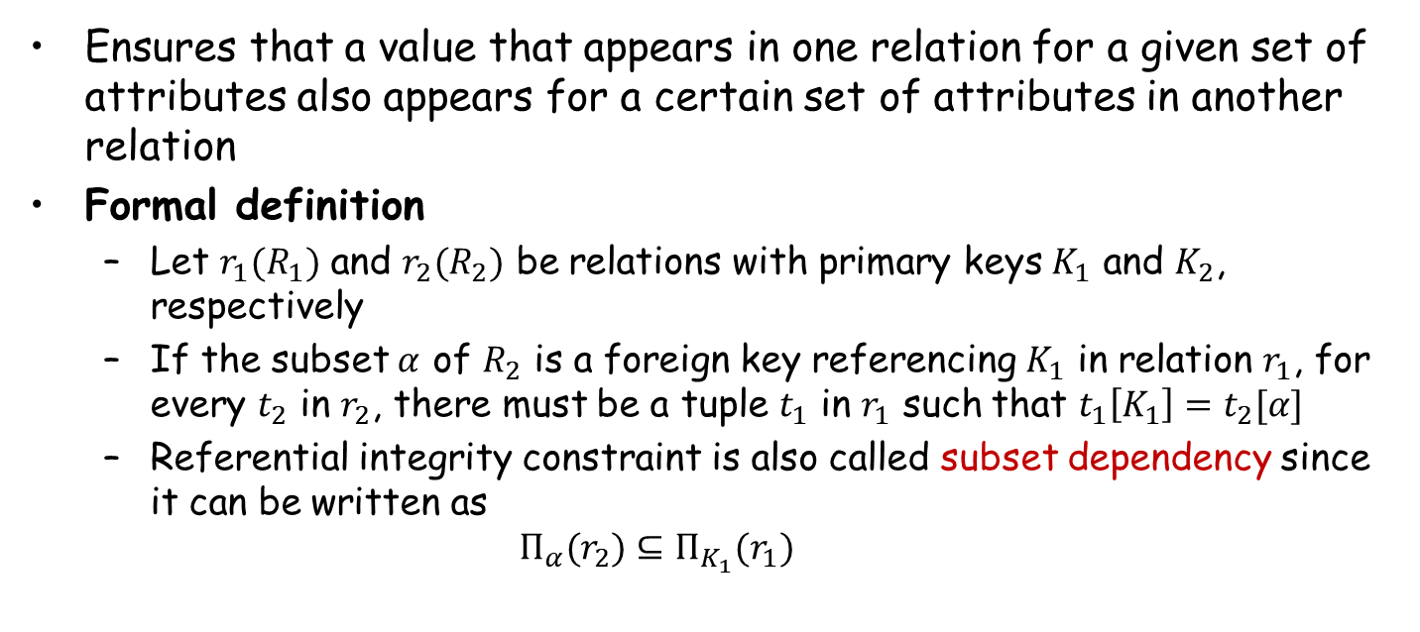
Referential Integrity (参照完整性)
Ensures that a value that appears in one relation for a given set of attributes also appears for a certain set of attributes in another relation
Formal definition
  Let $r_{1}(R_{1})$ and $r_{2}(R_{2})$ be relations with primary keys $K_{1}$ and $K_{2}$, respectively
  If the subset $α$ of $R_{2}$ is a foreign key referencing $K_{1}$ in relation $r_{1}$, for every $t_{2}$ in $r_{2}$, there must be a tuple $t_{1}$ in $r_{1}$ such that $t_{1}\left[K_{1}\right]=t_{2}[α]$
  Referential integrity constraint is also called subset dependency since it can be written as
  $Π_{α}(r_{2})⊆Π_{K_{1}}(r_{1})$

Slide 25
Integrity Constraint Violation
E.g.,
  create table person (
  ID char(10),
  name char(40),
  spouse char(10),
  primary key ID,
  foreign key spouse references person)
How to insert a tuple without causing constraint violation?
  Set spouse to null initially, update after inserting all persons (not possible if spouse attributes declared to be not null)
  OR defer constraint checking
    set constraints constraint_list deferred
Notes:
suppose we have a relation person with primary key name, and an attribute spouse, and suppose that spouse is a foreign key on person. That is, the constraint says that the spouse attribute must contain a name that is present in the person table. Suppose we wish to note the fact that John and Mary are married to each other by inserting two tuples, one for John and one for Mary, in the above relation, with the spouse attributes set to Mary and John, respectively. The insertion of the first tuple would violate the foreign-key constraint, regardless of which of the two tuples is inserted first. After the second tuple is inserted the foreign-key constraint would hold again. To handle such situations, the SQL standard allows a clause initially deferred to be added to a constraint specification; the constraint would then be checked at the end of a transaction, and not at intermediate steps. A constraint can alternatively be specified as deferrable, which means it is checked immediately by default, but can be deferred when desired. For constraints declared as deferrable, executing a statement set constraints constraint-list deferred as part of a transaction causes the checking of the specified constraints to be deferred to the end of that transaction

Slide 26
Complex Check Clauses
In relation section: check (time_slot_id in (select time_slot_id from time_slot))
  Can we use a foreign key here?
Every section is taught by at least one instructor
  check ((course_id, sec_id, semester, year) in (select course_id, sec_id, semester, year from teaches))
Unfortunately, subquery in check clause is not supported by many database systems
  Alternative: triggers (later)
Notes:
Another natural constraint on our university schema would be to require that every section has at least one instructor teaching the section. In an attempt to enforce this, we may try to declare that the attributes (course id, sec id, semester, year) of the section relation form a foreign key referencing the corresponding attributes of the teaches relation. Unfortunately, these attributes do not form a candidate key of the relation teaches. A check constraint similar to that for the time slot attribute can be used to enforce this constraint, if check constraints with subqueries were supported by a database system.

Slide 27
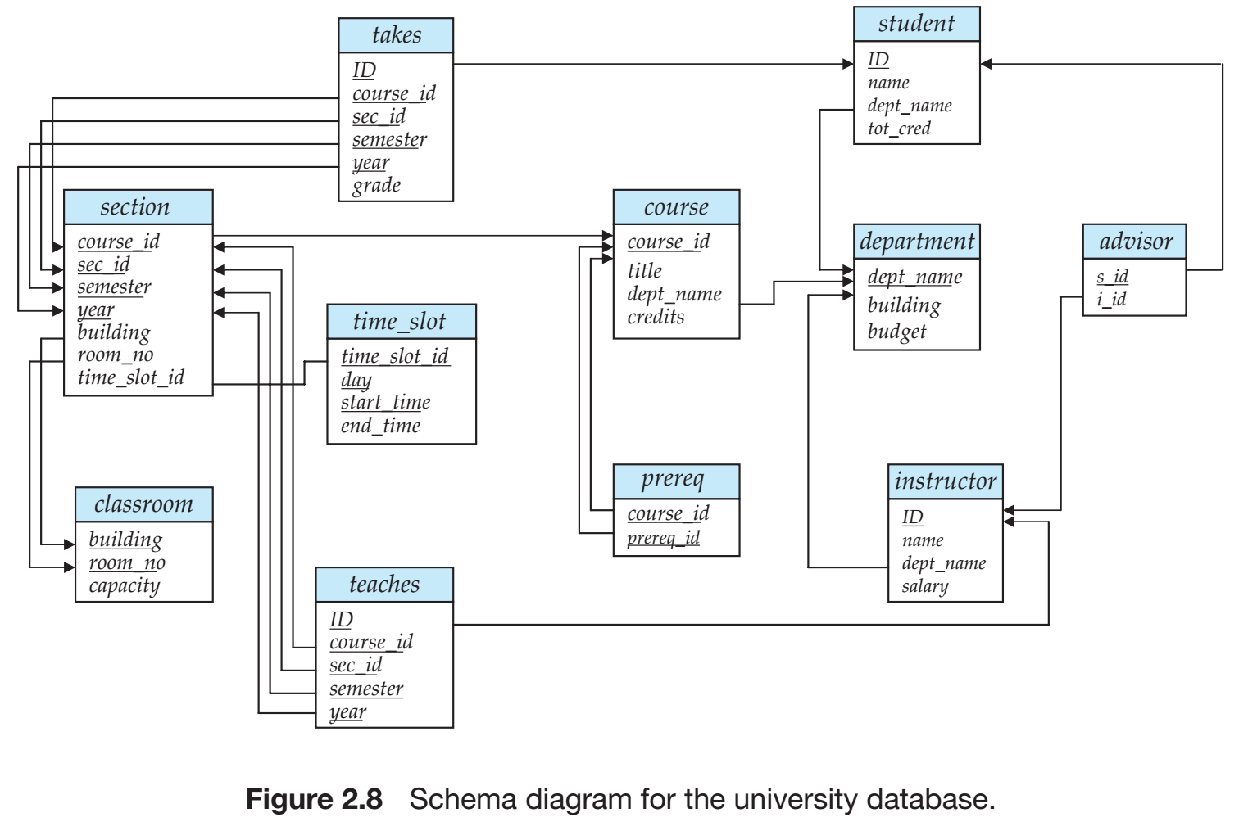
University Schema

Slide 28
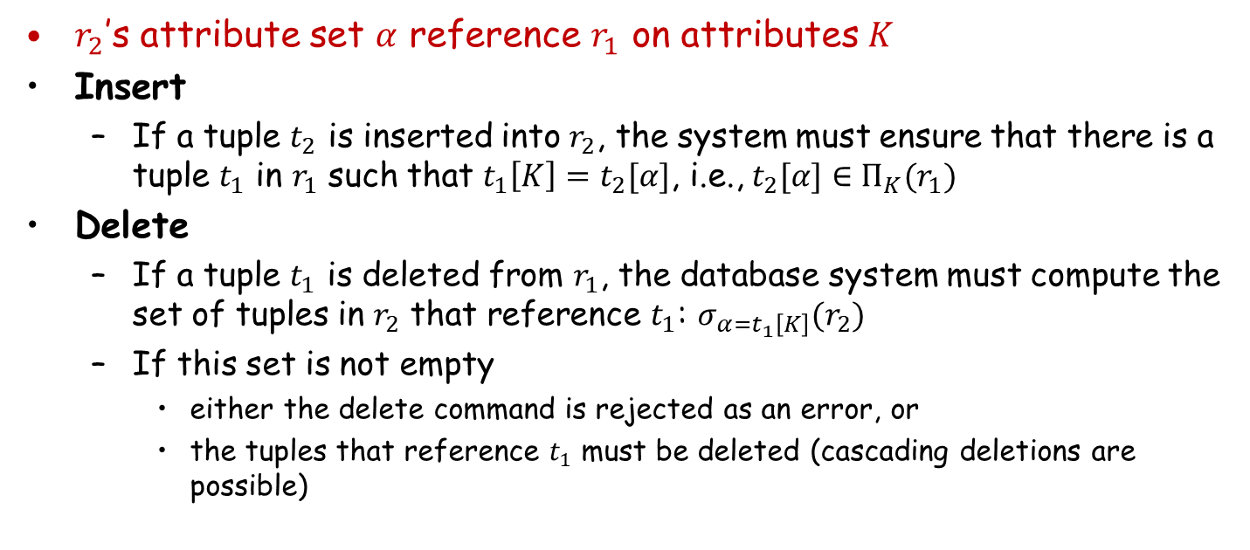
Database Modification
$r_{2}$’s attribute set $α$ reference $r_{1}$ on attributes $K$
Insert
  If a tuple $t_{2}$ is inserted into $r_{2}$, the system must ensure that there is a tuple $t_{1}$ in $r_{1}$ such that $t_{1}\left[K\right]=t_{2}[α]$, i.e., $t_{2}[α]∈Π_{K}(r_{1})$
Delete
  If a tuple $t_{1}$ is deleted from $r_{1}$, the database system must compute the set of tuples in $r_{2}$ that reference $t_{1}$: $σ_{α=t_{1}\left[K\right]}(r_{2})$
  If this set is not empty
    either the delete command is rejected as an error, or
    the tuples that reference $t_{1}$ must be deleted (cascading deletions are possible)

Slide 29
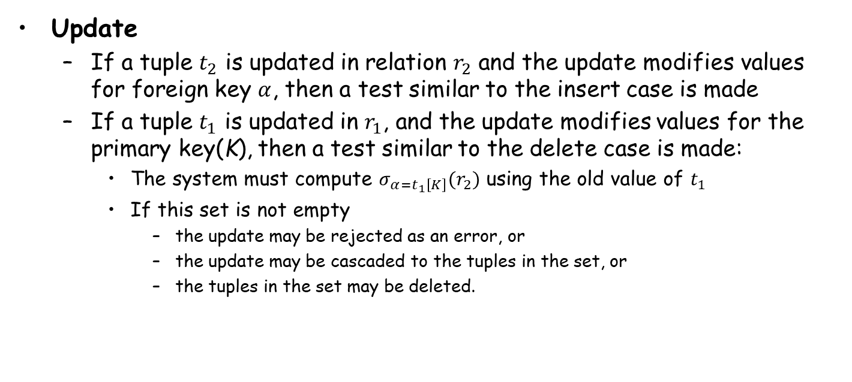
Database Modification (Cont.)
Update
  If a tuple $t_{2}$ is updated in relation $r_{2}$ and the update modifies values for foreign key $α$, then a test similar to the insert case is made
  If a tuple $t_{1}$ is updated in $r_{1}$, and the update modifies values for the primary key(K), then a test similar to the delete case is made:
    The system must compute $σ_{α=t_{1}\left[K\right]}(r_{2})$ using the old value of $t_{1}$
    If this set is not empty
      the update may be rejected as an error, or
      the update may be cascaded to the tuples in the set, or
      the tuples in the set may be deleted.

Slide 30
Referential Integrity in SQL
Primary, candidate, foreign keys can be specified as part of the SQL create table statement:
  The primary key clause
  The unique key clause
  The foreign key clause
By default, a foreign key references the primary key attributes of the referenced table
  foreign key (account_number) references account
Short form for specifying a single column as foreign key
  account_number char (10) references account

Slide 31
Referential Integrity in SQL
create table account
(account_number char(10),
branch_name char(15),
balance integer,
primary key (account_number),
foreign key (branch_name) references branch)；
create table depositor
(customer_name char(20),
account_number char(10),
primary key (customer_name, account_number),
foreign key (account_number) references account,
foreign key (customer_name) references customer)；
create table customer
(customer_name char(20),
customer_street char(30),
customer_city char(30),
primary key (customer_name))；
create table branch
(branch_name char(15),
branch_city char(30),
assets integer,
primary key (branch_name))；

Slide 32
Cascading Actions in Referential Integrity
create table course (
course_id char(5) primary key,
title varchar(20),
dept_name varchar(20) references department
)
create table course (
…
dept_name varchar(20),
foreign key (dept_name) references department
on delete cascade
on update cascade,
. . .
)
Due to the on delete cascade clauses, if a delete of a tuple in department results in referential-integrity constraint violation, the delete “cascades” to the course relation, the tuples that refer to the department that should be deleted
Cascading updates are similar
Notes:
Because of the clause on delete cascade associated with the foreign-key declaration, if a delete of a tuple in department results in this referential-integrity constraint being violated, the system does not reject the delete. Instead, the delete “cascades” to the course relation, deleting the tuple that refers to the department
that was deleted. Similarly, the system does not reject an update to a field referenced by the constraint if it violates the constraint; instead, the system updates
the field dept name in the referencing tuples in course to the new value as well.
SQL also allows the foreign key clause to specify actions other than cascade, if
the constraint is violated, the referencing field (here, dept name) can be set to null
(by using set null in place of cascade), or to the default value for the domain (by
using set default).

Slide 33
Cascading Actions in SQL (Cont.)
If there is a chain of foreign-key dependencies across multiple relations, with on delete cascade specified for each dependency, a deletion or update at one end of the chain can propagate across the entire chain
Referential integrity is only checked at the end of a transaction
  Intermediate steps are allowed to violate referential integrity provided later steps remove the violation
  Otherwise, it would be impossible to create some database states, e.g. inserting two tuples whose foreign keys point to each other
    E.g., spouse attribute of relation married_person(name, address, spouse)
…

Slide 34
Referential Integrity in SQL (Cont.)
Alternative to cascading
  on delete set null
  on delete set default
Null values in foreign key attributes complicate SQL referential integrity semantics
  if any attribute of a foreign key is null, the tuple is defined to satisfy the foreign key constraint
Notes:
外键属性中的 Null 值会使 SQL 引用完整性语义复杂化, 最好避免使用
用 not null 来限制

Slide 35
Assertions (断言)
An assertion is a predicate expressing a condition that we wish the database always to satisfy
An assertion in SQL takes the form
create assertion <assertion-name> check <predicate>
When an assertion is made, the system tests it for validity, and tests it again on every update that may violate the assertion
  This testing may introduce a significant amount of overhead; hence assertions should be used with great care

Slide 36
Example
The sum of all loan amounts for each branch must be less than the sum of all account balances at the branch
create assertion sum_constraint check
(not exists
(select * from branch
where (select sum(amount) from loan
where loan.branch_name = branch.branch_name)
>= (select sum(balance) from account
where account.branch_name = branch.branch_name)))

Slide 37
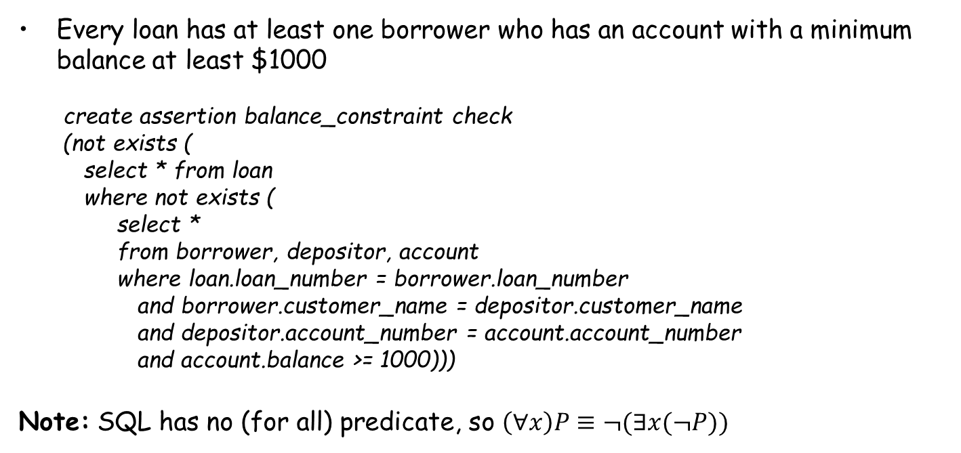
Example
Every loan has at least one borrower who has an account with a minimum balance at least $1000
  create assertion balance_constraint check
  (not exists (
  select * from loan
  where not exists (
  select *
  from borrower, depositor, account
  where loan.loan_number = borrower.loan_number
  and borrower.customer_name = depositor.customer_name
  and depositor.account_number = account.account_number
  and account.balance >= 1000)))
Note: SQL has no (for all) predicate, so $\left(∀x\right)P≡¬(∃x(¬P))$

Slide 38
Outline
Join Expressions
Views
Transactions
Integrity Constraints
Data Types in SQL
Index Definition in SQL
Authorization

Slide 39
Built-in Data Types in SQL
date: containing year, month and day
  E.g., date ‘2005-07-27’
time: time of day, in hours, minutes and seconds
  E.g., time ‘09:00:30’ , time ‘09:00:30.75’
timestamp: date + time of day
  E.g., timestamp ‘2005-07-27 09:00:30.75’
  timestamp (p): specifies the number of digits after the decimal point
interval: period of time
  E.g., interval ‘1’ day
  Subtracting a date/time/timestamp value from another gives an interval value
  Interval values can be added to date/time/timestamp
Notes:
built-in data types supported in SQL, such as integer types, real types, and character types. There are additional built-in data
types supported by SQL.
75’为时区timezone

Slide 40
Built-in Data Types in SQL (Cont.)
Extract values of individual fields from date/time/timestamp
  extract (year from current_date)
Cast string types to date/time/timestamp
  cast <string-valued-expression> as date
  cast <string-valued-expression> as time

Slide 41
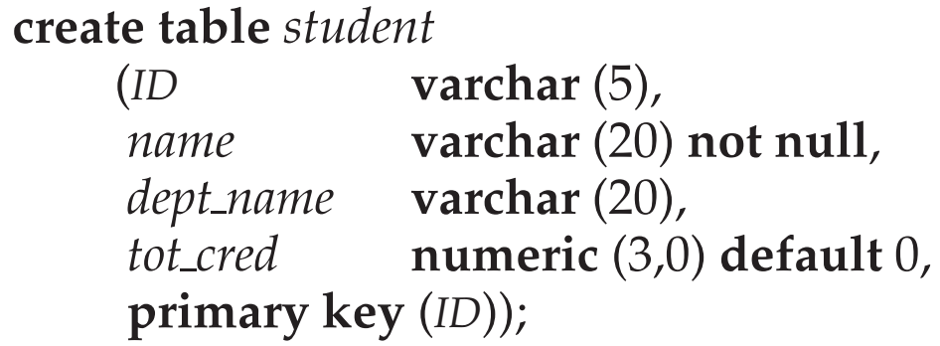
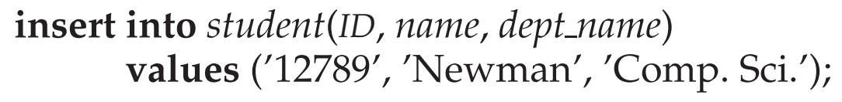
Default Values
Specify a default value for an attribute
How an insertion can omit the value for the tot_cred attribute?

Slide 42
Large Object Types
Large objects (photos, videos, CAD files, etc.) are stored as a large object
  blob (binary large object): object is a large collection of uninterpreted binary data. The interpretation is left to an application outside of the database system
  image blob (10MB)
  movie blob(2GB)
  clob (character large object): object is a large collection of character data
  book_review clob(10KB)
  When a query returns a large object, a locator (pointer) is returned rather than the large object itself

Slide 43
User Defined Types
Create type construct in SQL creates user-defined type
  create type Dollars as numeric (12,2) [final]
Create domain construct in SQL-92 creates user-defined domain types
  create domain person_name char(20) not null
Types and domains are similar. Domains can have constraints, such as not null/default values, specified on them
  create domain degree_level varchar(10)
  constraint degree_level_test check (value in (’Bachelors’, ’Masters’, ’Doctorate’));
Notes:
12 digits, two of which are placed after the decimal point
Final表示变量类型不能改变。
It is possible for several attributes to have the same data type.
An attempt to assign a value of type Dollars to a variable of type Pounds results in a compile-time error, although both are of the same numeric type. Such an assignment is likely to be due to a programmer error, where the programmer forgot about the differences in currency. Declaring different types for different currencies helps catch such errors.

Slide 44
Outline
Join Expressions
Views
Transactions
Integrity Constraints
Data Types in SQL
Index Definition in SQL
Authorization

Slide 45
Index Creation
Many queries reference only a small proportion of the records in a table.
It is inefficient for the system to read every record to find a record with particular value
An index on an attribute of a relation is a data structure that allows the database system to find those tuples in the relation that have a specified value for that attribute efficiently, without scanning through all the tuples of the relation.
Create an index:
create index <name> on <relation-name> (attribute);

Slide 46
Index Creation Example
create table student
(ID varchar (5),
name varchar (20) not null,
dept_name varchar (20),
tot_cred numeric (3,0) default 0,
primary key (ID))
create index studentID_index on student(ID)
The following query can be executed by using the index to find the required record, without looking at all records of student
select *
from student
where ID = '12345'

Slide 47
Outline
Join Expressions
Views
Transactions
Integrity Constraints
Data Types in SQL
Index Definition in SQL
Authorization

Slide 48
Security
Security - protection from malicious attempts to steal or modify data
  Database system level
    Authentication and Authorization mechanisms to allow specific users access only to the required data
  Operating system level
    Operating system superusers can do anything they want to the database
  Network level: use encryption to prevent
    Eavesdropping (窃听，unauthorized reading of messages)
    Masquerading (冒充，pretending to be an authorized user or sending messages supposedly from authorized users)
Notes:
Eavesdropping ['iːvz.drɒp]：偷听。
Supposedly ：假冒

Slide 49
Security (Cont.)
Security - protection from malicious attempts to steal or modify data.
  Physical level
    Physical access to computers allows destruction of data by intruders, and traditional lock-and-key security is needed
    Computers must also be protected from floods, fire, etc.
  Human level
    Users must ensure that authorization is not given to intruders
    Users should be trained on password selection and secrecy
Notes:
用户必须经过筛选

Slide 50
Authorization
Types of authorization on parts of the database
  Read authorization - allows reading, but not modification of data
  Insert authorization - allows insertion of new data, but not modification of existing data
  Update authorization - allows modification, but not deletion of data
  Delete authorization - allows deletion of data
Types of authorization to modify the database schema
  Index authorization - allows creation and deletion of indices
  Resources authorization - allows creation of new relations
  Alteration authorization - allows addition or deletion of attributes
  Drop authorization - allows deletion of relations

Slide 51
Authorization on Views
Ability of views to hide data serves both to simplify usage of the system and to enhance security by allowing users access only to data they need for their job
A combination of relational-level security and view-level security can precisely limit a user’s access to the data that he needs

Slide 52
View Example
Suppose a bank clerk Deny needs to know the names of the customers of each branch, but is not authorized to see specific loan information
  The cust_loan view is defined as follows:
create view cust_loan as
select branch_name, customer_name
from borrower, loan
where borrower.loan_number = loan.loan_number

Slide 53
View Example (Cont.)
The clerk is authorized to see the result of the query:
select * from cust_loan
When the query processor translates the result into a query on the actual relations in the database, we obtain a query on borrower and loan
Authorization must be checked on the clerk’s query before query processing replaces a view by the definition of the view

Slide 54
Authorization on Views
Creation of a view does not require resources authorization since no real relation is being created
The creator of a view gets only those privileges that provide no additional authorization beyond that he already had
  E.g., if creator of view cust_loan had only read authorization on borrower and loan, he gets only read authorization on cust_loan

Slide 55
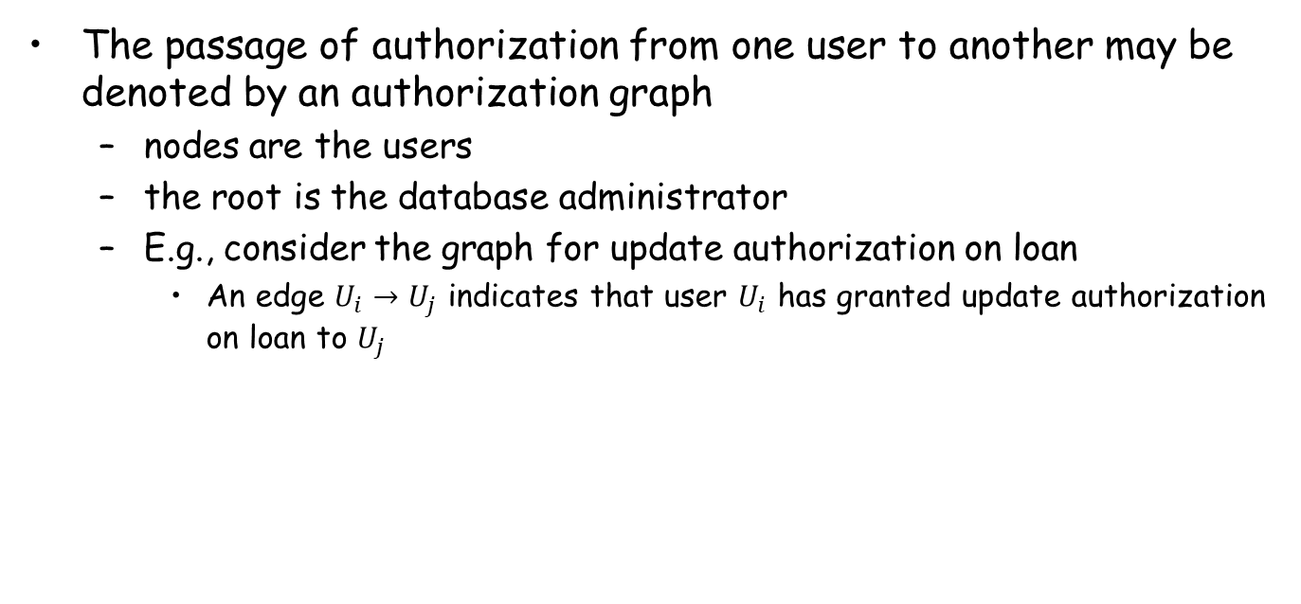
Transfer/Granting of Privileges
The passage of authorization from one user to another may be denoted by an authorization graph
  nodes are the users
  the root is the database administrator
  E.g., consider the graph for update authorization on loan
    An edge $U_{i}→U_{j}$ indicates that user $U_{i}$ has granted update authorization on loan to $U_{j}$
U₁
U₄
DBA
U₂
U₅
U₃

Slide 56
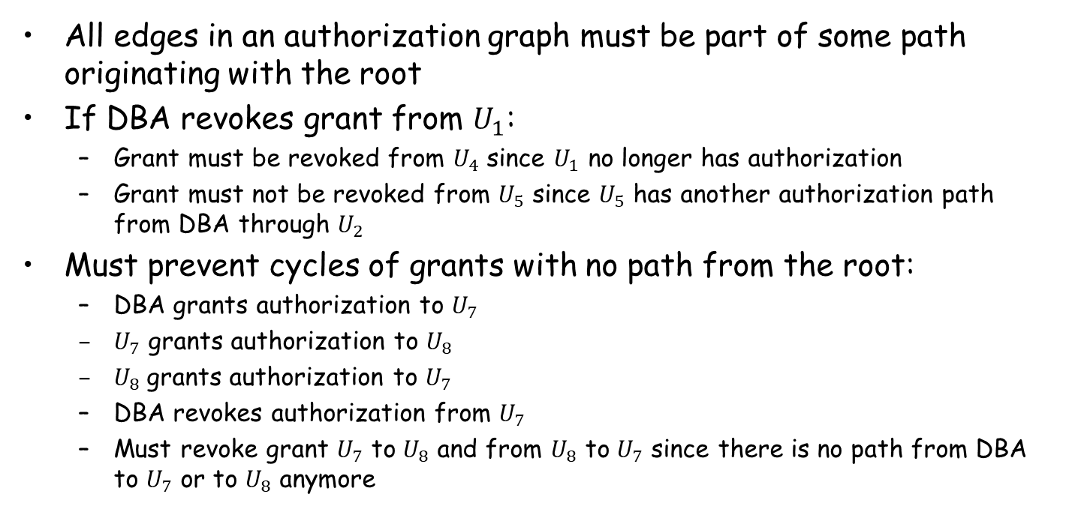
Authorization Grant Graph
All edges in an authorization graph must be part of some path originating with the root
If DBA revokes grant from $U_{1}$:
  Grant must be revoked from $U_{4}$ since $U_{1}$ no longer has authorization
  Grant must not be revoked from $U_{5}$ since $U_{5}$ has another authorization path from DBA through $U_{2}$
Must prevent cycles of grants with no path from the root:
  DBA grants authorization to $U_{7}$
  $U_{7}$ grants authorization to $U_{8}$
  $U_{8}$grants authorization to $U_{7}$
  DBA revokes authorization from $U_{7}$
  Must revoke grant $U_{7}$ to $U_{8}$ and from $U_{8}$ to $U_{7}$ since there is no path from DBA to $U_{7}$ or to $U_{8}$ anymore

Slide 57
Security Specification in SQL
The grant statement is used to confer authorization
grant <privilege list>
on <relation name or view name>
to <user list>
<user list>
  a user-id
  public, which allows all valid users the privilege granted
  A role (more on this later)
Granting a privilege on a view does not imply granting any privileges on the underlying relations
The grantor of the privilege must already hold the privilege on the specified item

Slide 58
Privileges in SQL
select: allows read access to relation, or the ability to query using the view
  E.g., grant select on branch to U₁, U₂, U₃
insert: the ability to insert tuples
update: the ability to update using the SQL update statement
delete: the ability to delete tuples
references: ability to declare foreign keys when creating relations
usage: In SQL-92, authorizes a user to use a specified domain
all privileges: used as a short form for all the allowable privileges

Slide 59
Privilege to Grant Privileges
with grant option
  Allow a user who is granted a privilege to pass the privilege on to other users
  E.g., give U₁ the select privilege on branch and allows U₁ to grant this privilege to others
grant select on branch to U₁ with grant option

Slide 60
Roles (角色)
Roles permit common privileges for a class of users can be specified just once by creating a corresponding “role”
Privileges can be granted to or revoked from roles, just like user
Roles can be assigned to users, and even to other roles
create role teller
create role manager
grant select on branch to teller
grant update (balance) on account to teller
grant all privileges on account to manager
grant teller to manager
grant teller to alice, bob
grant manager to avi

Slide 61
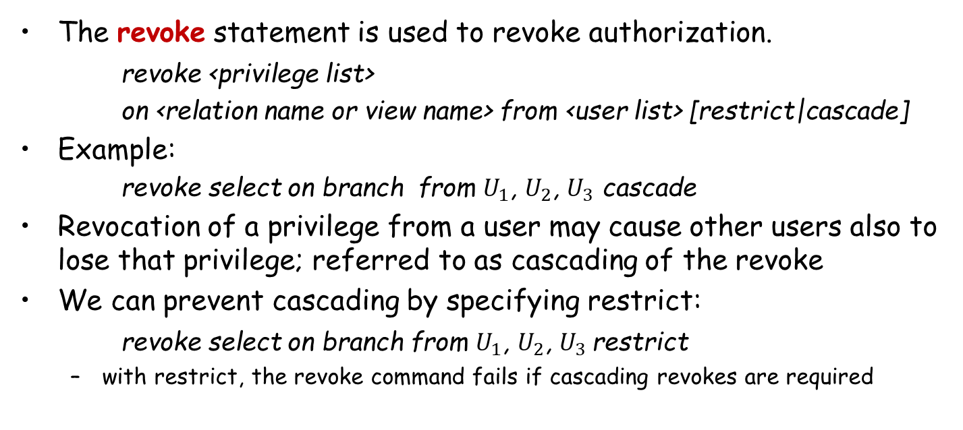
Revoking Authorization in SQL
The revoke statement is used to revoke authorization.
revoke <privilege list>
on <relation name or view name> from <user list> [restrict|cascade]
Example:
    revoke select on branch from $U_{1}$, $U_{2}$, $U_{3}$ cascade
Revocation of a privilege from a user may cause other users also to lose that privilege; referred to as cascading of the revoke
We can prevent cascading by specifying restrict:
revoke select on branch from $U_{1}$, $U_{2}$, $U_{3}$restrict
  with restrict, the revoke command fails if cascading revokes are required

Slide 62
Revoking Authorization in SQL (Cont.)
<privilege-list> may be all to revoke all privileges
If <revoke-list> includes public, all users lose the privilege except those granted it explicitly
If the same privilege was granted twice to the same user by different grantees, the user may retain the privilege after the revocation
All privileges that depend on the privilege being revoked are also revoked
Notes:
If <revokee-list> includes public all users lose the privilege except those granted it explicitly？

Slide 63
Limitations of SQL Authorization
SQL does not support authorization at a tuple level
  E.g., we cannot restrict students to see only their own grades
With the growth in Web access to databases, database accesses come primarily from application servers
  End users don't have database user ids, they are all mapped to the same database user id
The task of authorization in such cases falls on the application program, with no support from SQL
  Benefit
    fine-grained authorizations, such as to individual tuples, can be implemented by the application.
  Drawbacks
    Authorization must be done in application code, and may be dispersed all over the application
    Checking for the authorization loopholes (漏洞) becomes very difficult since it requires reading large amounts of application code
Notes:
Loophole：漏洞。

Slide 64
Audit Trails (审计追踪)
An audit trail is a log of all changes (inserts / deletes / updates) to the database along with information such as
  which user performed the change
  when the change was performed
Used to track erroneous/fraudulent(欺骗性的) updates
Can be implemented using triggers, but many database systems provide direct support
Notes:
Audit Trails: 审计追踪

Slide 65
Encryption
Data may be encrypted when database authorization provisions do not offer sufficient protection
Properties of good encryption technique:
  Relatively simple for authorized users to encrypt and decrypt data
  Encryption scheme depends not on the secrecy of the algorithm but on the secrecy of a parameter of the algorithm called the encryption key (密钥)
  Extremely difficult for an intruder to determine the encryption key
Notes:
Provisions: 规定
Encryption scheme: 加密策略
Secrecy: 保密性

Slide 66
Encryption (Cont.)
Data Encryption Standard (DES)
  Substitutes characters and rearranges their order on the basis of an encryption key which is provided to authorized users via a secure mechanism
  Scheme is no more secure than the key transmission mechanism since the key has to be shared
Advanced Encryption Standard (AES)
  a new standard replacing DES, and is based on the Rijndael algorithm, but is also dependent on shared secret keys
Notes:
Rijndael: 分组密码

Slide 67
Encryption (Cont.)
Public-key encryption
  each user has two keys:
    public key – used to encrypt data, but cannot be used to decrypt data
    private key -- used to decrypt data
  Encryption scheme is impossible or extremely hard to decrypt data given only the public key
  The RSA public-key encryption scheme is based on the hardness of factoring a very large number (100s of digits) into its prime components.

Slide 68
Review Terms
Join types
  Inner and outer join
  Left, right and full outer join
  Natural, using, and on
View definition
Materialized views
View update
Transactions
  Commit work
  Rollback work
  Atomic transaction
Integrity constraints
Domain constraints
Unique constraint
Check clause
Referential integrity
  Cascading deletes
  Cascading updates
Assertions
Date and time types
Default values
Indices
Large objects
User-defined types
Domains
Schemas
Authorization
Privileges
  select
  insert
  update
  All privileges
  Granting of privileges
  Revoking of privileges
  Privilege to grant privileges
  Grant option
Roles
Authorization on views
Execute authorization
Invoker privileges
Row-level authorization

Slide 69
Homework
Exercises
  4.7, 4.16
Submission
  Canvas上提交，上传单个PDF文件

Slide 70
End of Chapter 4

